Slide 1
Using the ChatGPT API in R
Abigail Haddad
June 28, 2023

Slide 2
Takeaways
When using a single prompt across different pieces of text, use the ChatGPT API

Slide 3
Generating fake resumes
Inputs:
“generate a resume” prompt
.csv file that I wrote with fake names, academic backgrounds, and bios
Outputs:
Fake resumes for each fake candidate

Slide 4
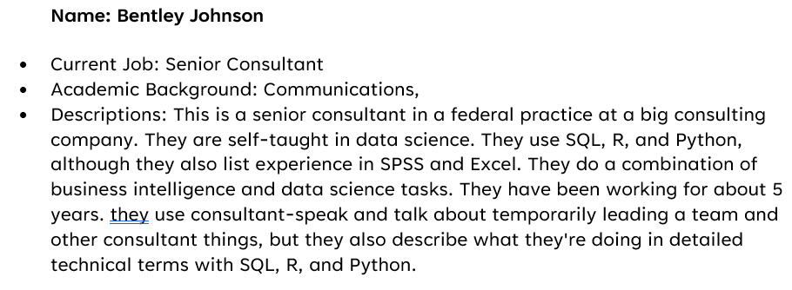
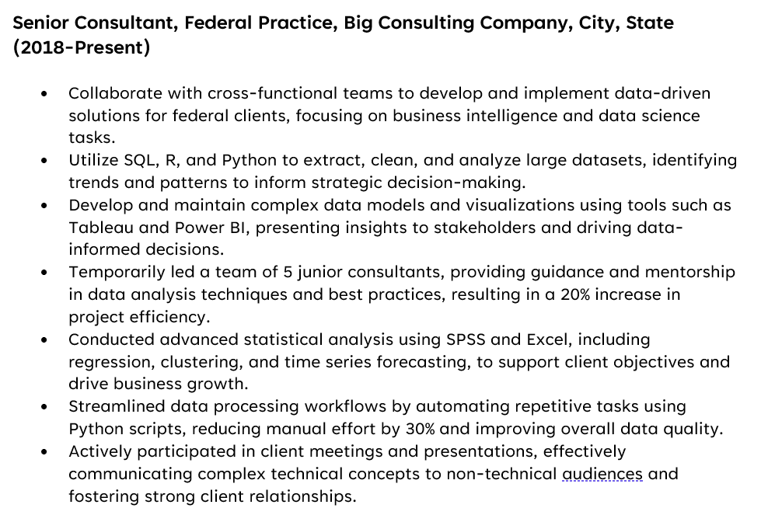
Example Input and Output
Sample Input Text
Resume Excerpt

Slide 5




R Code

Slide 6
Process
Read in your text
Use With ChatGPT API
Evaluate the Results
Get your text from your .csv file, API, etc.
Concatenate it with your prompt
Sending a block of text
Getting back a result
Putting in a table/data frame
Informally: does it look like you want?
Formally: via comparing with your ‘labeled’ data and using metrics like a confusion matrix

Slide 7
Other Use Cases
Text Summarization
Classification
Named Entity Recognition
Summarize this text
Summarize this candidate’s software development background
Is this job a ‘data science’ job?
What topics is this text about?
What tools and software are in this job listing?
What locations are mentioned on this resume?

Slide 8
For More Information
https://github.com/abigailhaddad/resume_generation_R
Abigail@datasciencedc.org

